Slide 1
Practice on Essential Enterprise Architecture Tool
001
Opening and Introduction

Slide 2
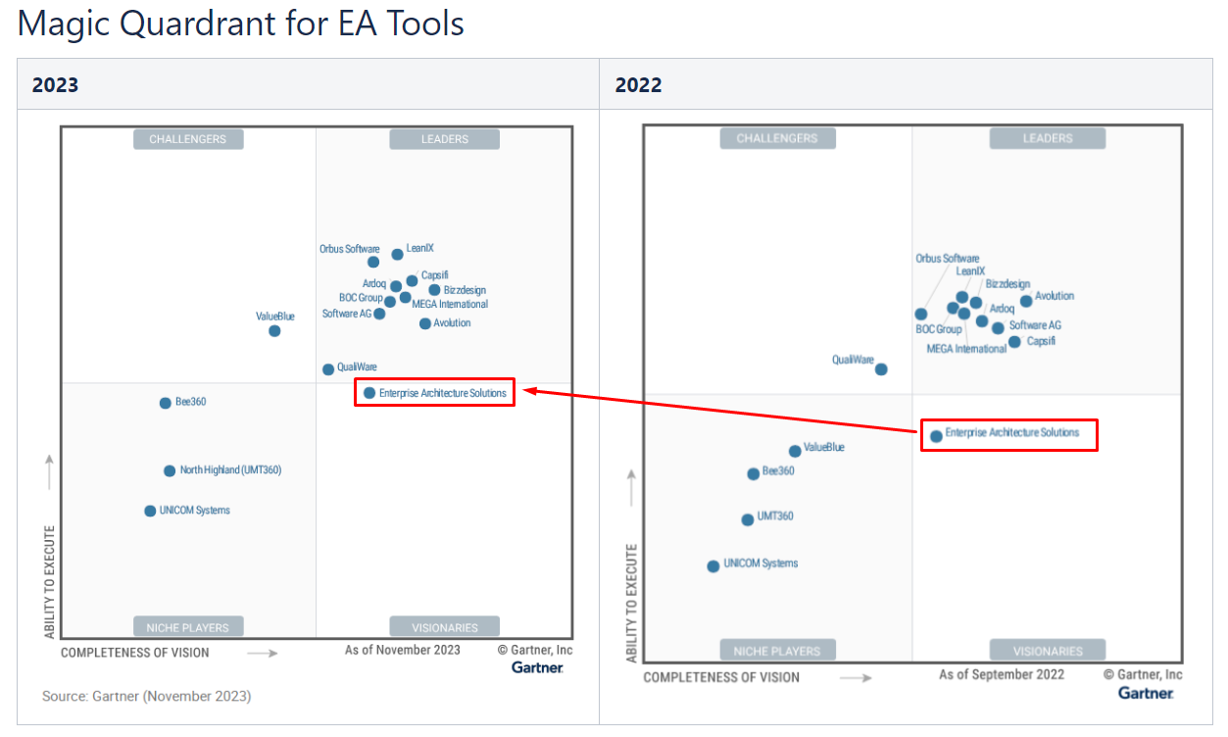
Positioning of Essential

